Slide 1
1 Introduction to Networking (06)
-Compiled by UBM
(Most of the study material taken from Javatpoint.com and tutorialspoint.com

Slide 2
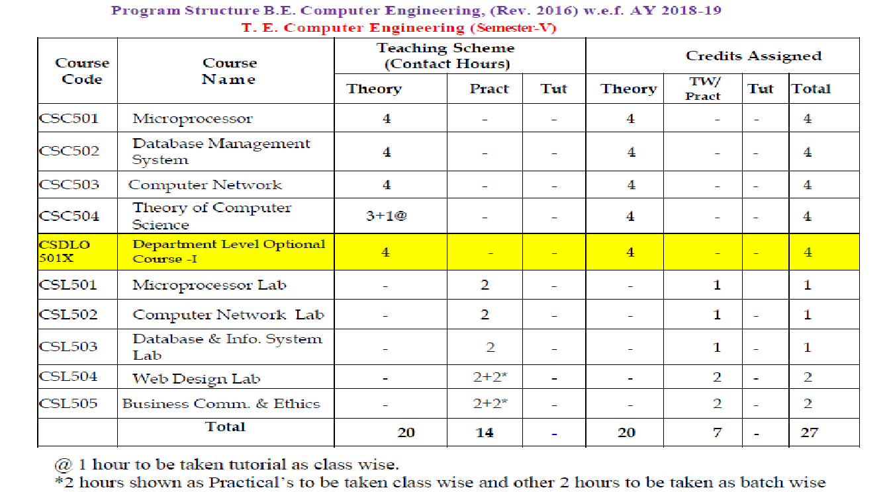

Slide 3
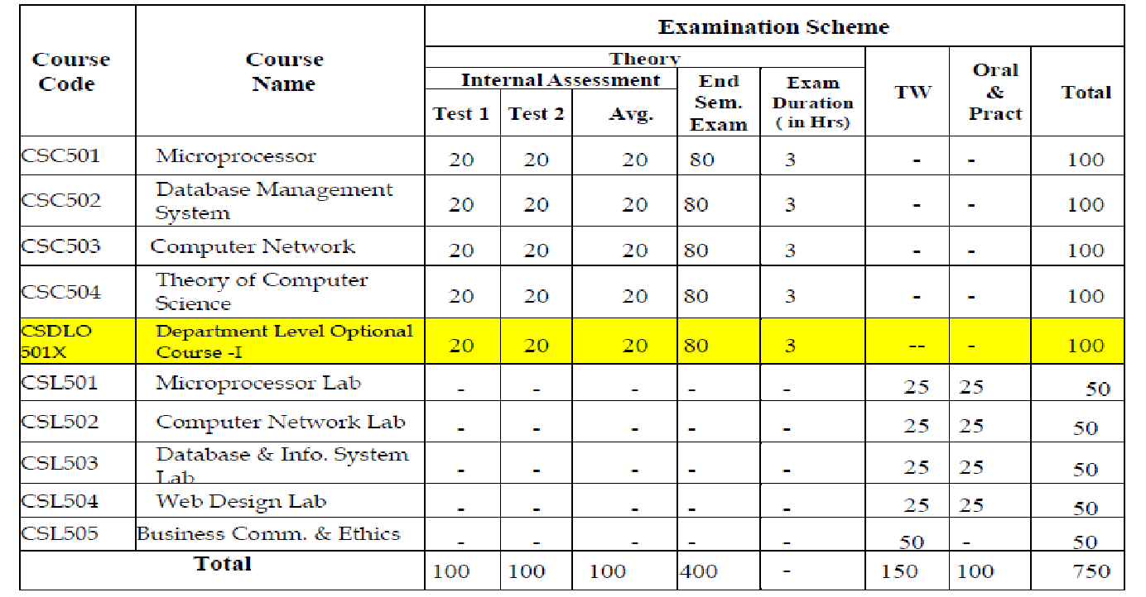

Slide 4
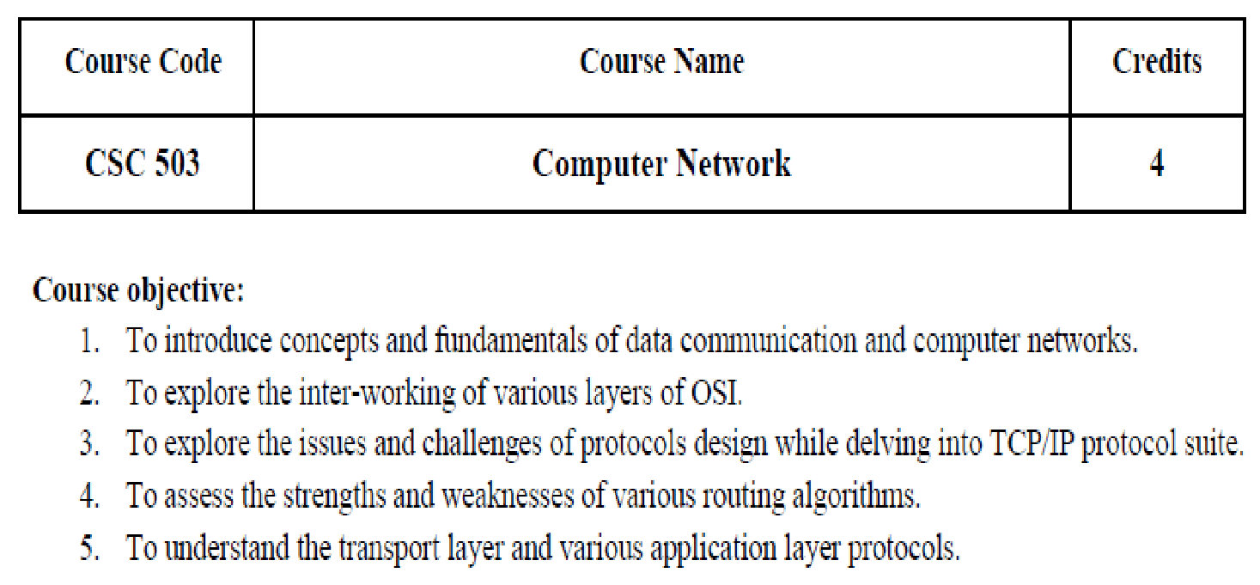

Slide 5
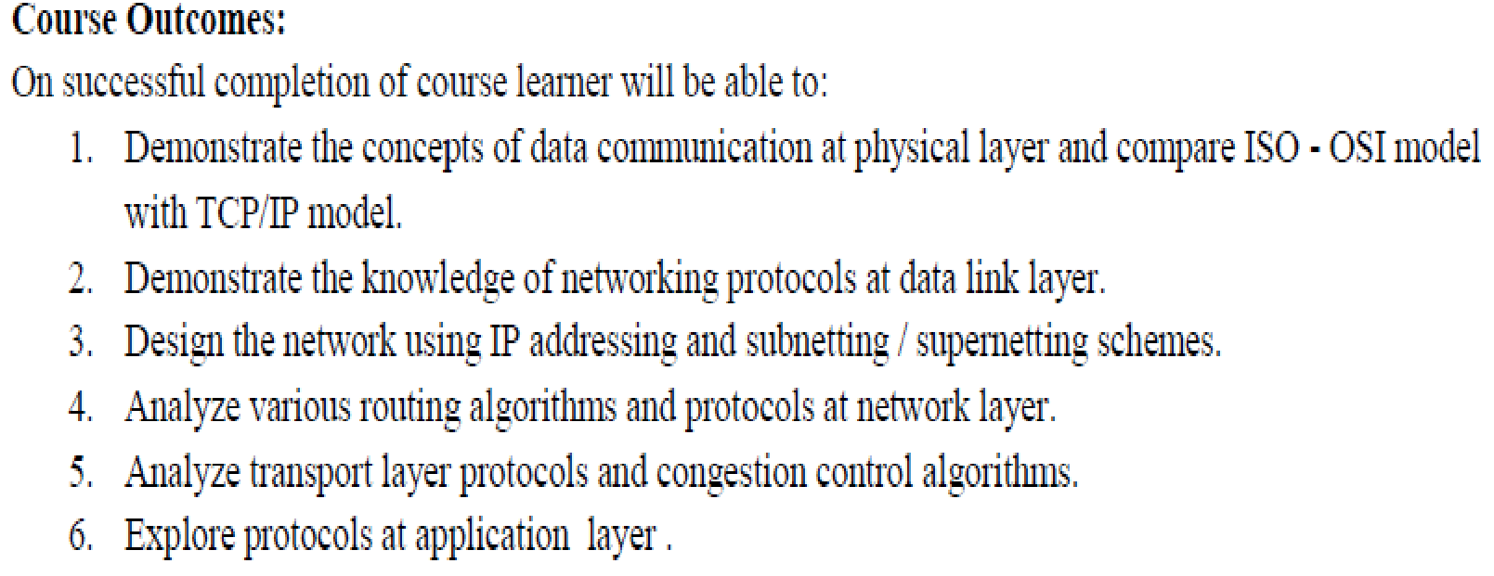

Slide 6
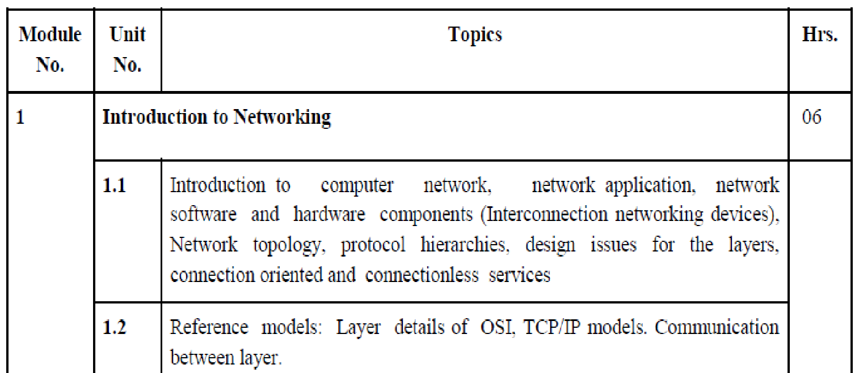

Slide 7
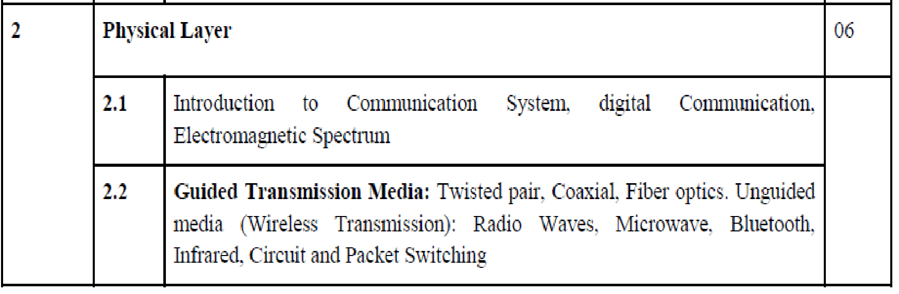

Slide 8
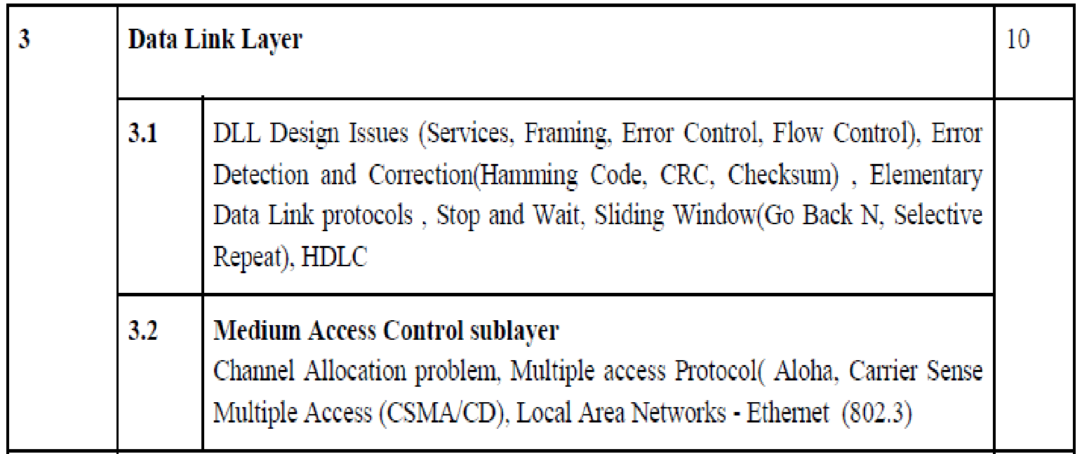

Slide 9
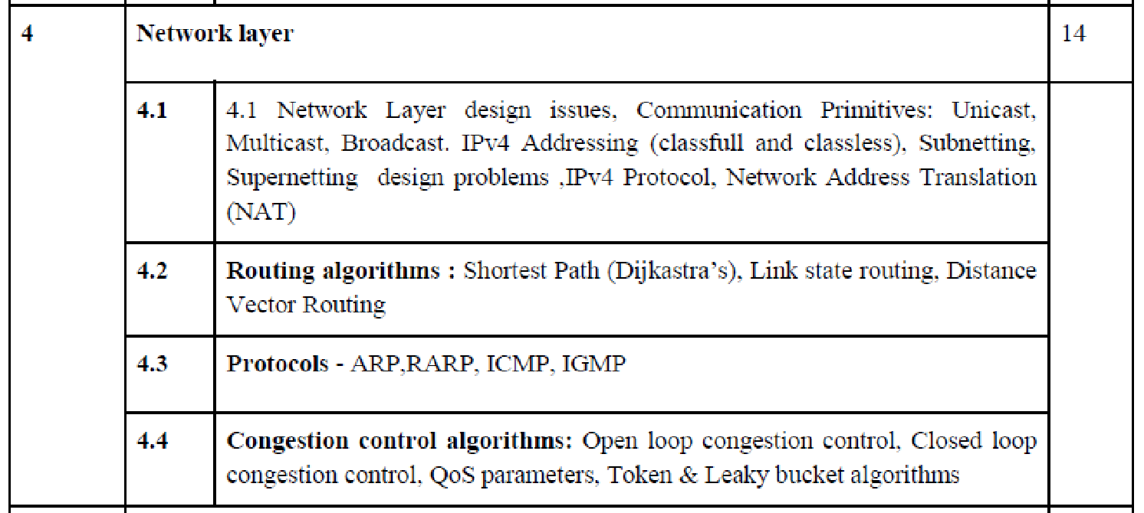

Slide 10
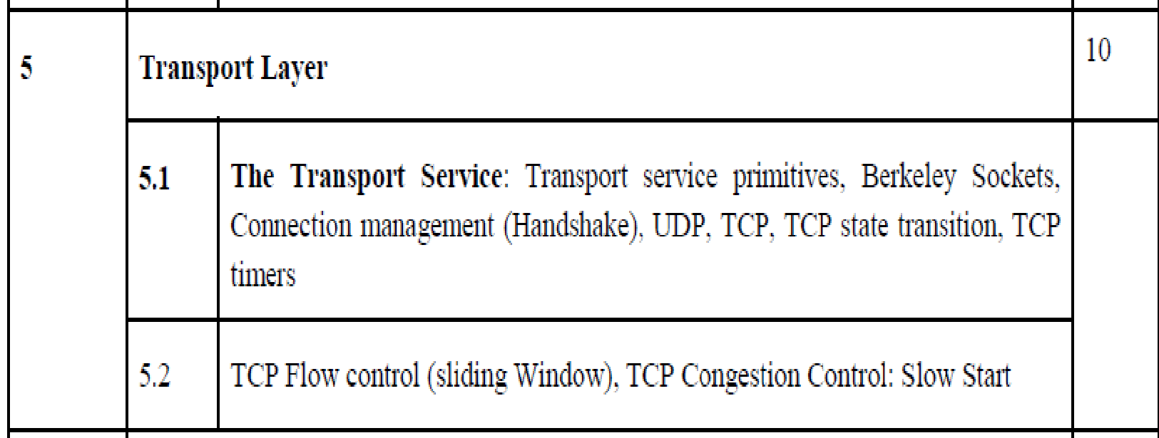

Slide 11
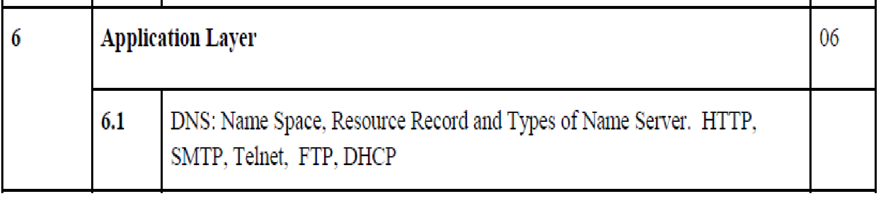

Slide 12
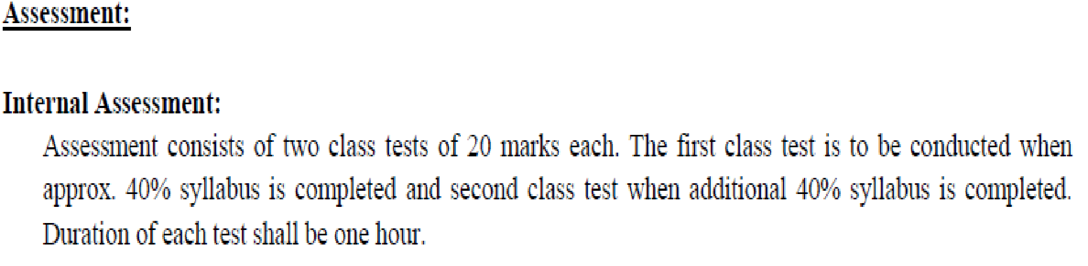
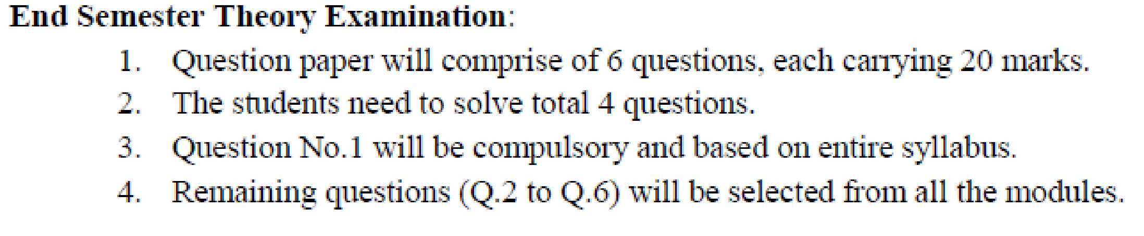

Slide 13
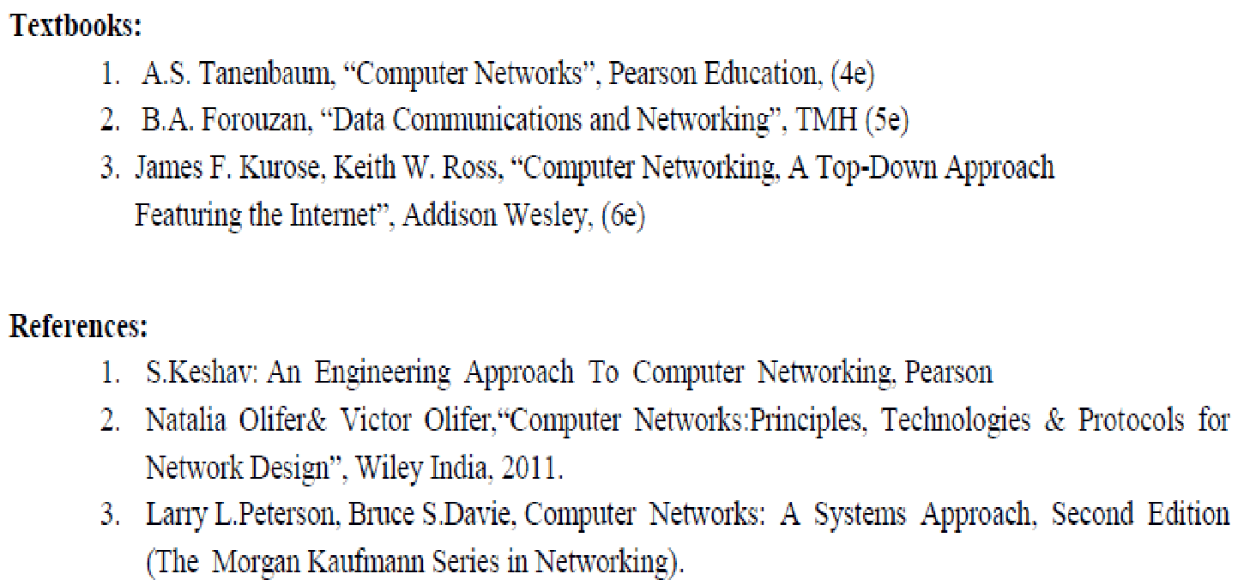

Slide 14
TERNA PUBLIC CHARITABLE TRUST’S
TERNA ENGINEERING COLLEGE, Neural
Department of Computer Engineering
Lesson Plan and Syllabus Coverage
Academic year 2020-21 (Odd Semester)
Term Duration: From 6/7/2020 to 22/10/2020
(Umesh B Mantale)

Slide 15
Name of the subject: CSC 503 Computer Network
Class/ Semester: TE(Div: B) Semester-V
Course Objective and Outcomes
Part (1)Course Objectives
1. To introduce concepts and fundamentals of data communication and computer networks.
2. To explore the inter-working of various layers of OSI.
3. To explore the issues and challenges of protocols design while delving into TCP/IP protocol suite.
4. To assess the strengths and weaknesses of various routing algorithms.
5. To understand the transport layer and various application layer protocols.

Slide 16
Part (2) Course Outcomes
On successful completion of course learner will be able to:
1. Demonstrate the data communication at physical layer and compare ISO - OSI model with TCP/IP model.
2. Demonstrate the functioning of networking protocols used in data link layer.
3. Design the network using IP addressing and sub netting / super netting schemes.
4. Analyze various routing protocols and congestion control algorithms used in network layer.
5. Analyze transport layer protocols and congestion control algorithms.
6. Exploration of protocols used in application layer.

Slide 17
Pre Requisites
Digital Communication Fundamentals

Slide 18
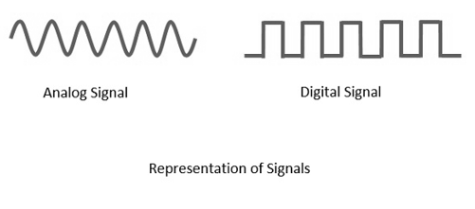
Analog and Digital Signals

Slide 19
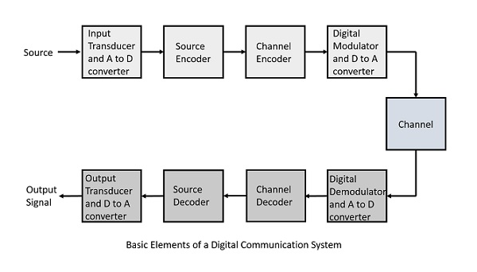
Digital Communication System

Slide 20
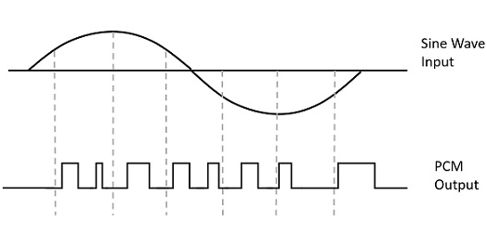
Pulse Code Moduation

Slide 21
Digital techniques
Number system
Binary representation
Binary arithmetic's
Boolean algebra
Buffer

Slide 22
What is a Computer Network?
Computer Network is a group of computers connected with each other through wires or wireless, optical fibres or optical links so that various devices can interact with each other through a network.
Why computer network ?
For sharing of resources among various devices.

Slide 23
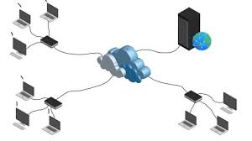
Computer Network

Slide 24
Applications Of Computer Network
Resource sharing: File, Printer, Scanner, Application etc.
Server-Client model: used in the server-client model.
Communication medium: behaves as a communication medium among the users. – Email, Voicemail, Video Conferencing, Online Teaching, News etc.
E-commerce: important in businesses. – Amazon, Ebay, Flipkart, Alibaba etc.

Slide 25
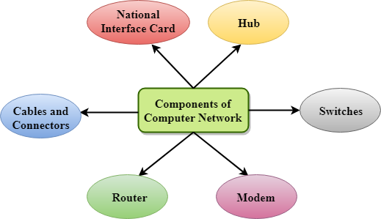
Components Of Computer Network
Network

Slide 26
NIC(Network interface card)
NIC is a device that helps the computer to communicate with another device.
The network interface card contains
the hardware addresses, the data-link layer protocol uses this address
There are two types of NIC: wireless NIC and wired NIC.
Wireless NIC: All the modern laptops use the wireless NIC. In Wireless NIC, a connection is made using the antenna that employs the radio wave technology.
Wired NIC: Cables use the wired NIC to transfer the data over the medium.

Slide 27
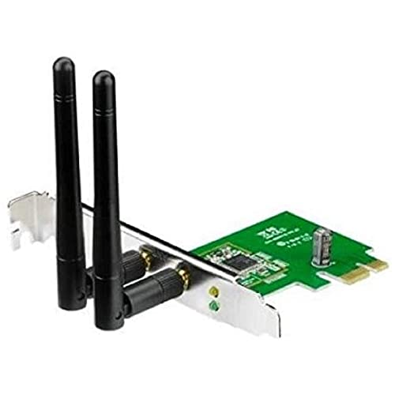
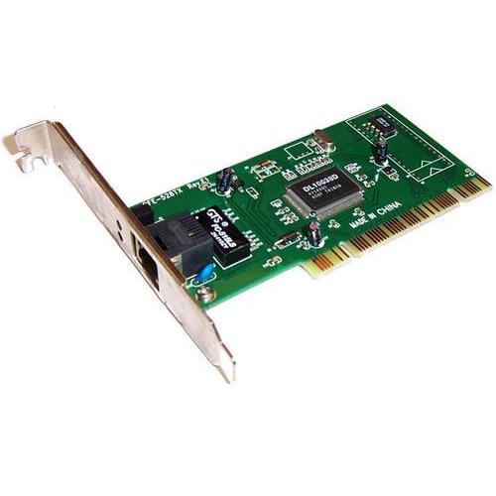
NIC
Wired Network Interface Card
Wireless Network Interface Card

Slide 28
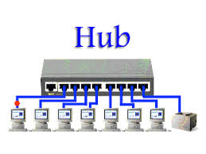
Hub
Hub is a central device that splits the network connection into multiple devices.
When computer requests for information from a computer, it sends the request to the Hub.
Hub distributes this request to all the interconnected computers.

Slide 29
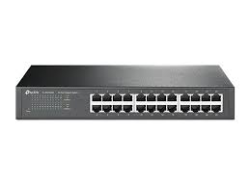
Switches
Switch is a networking device
Used to connect devices over the network to transfer the data to another device.
A switch is better than Hub as it does not broadcast the message
Switch sends the message directly from source to the destination.

Slide 30
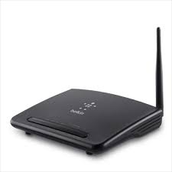
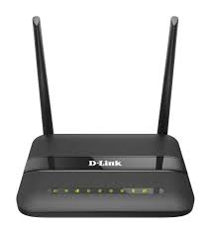
Router
Router is a device that connects the LAN to the internet.
The router is mainly used to connect the distinct networks or connect the internet to multiple computers.
Routers will normally create, add, or divide on the Network Layer as they are normally IP-based devices.

Slide 31
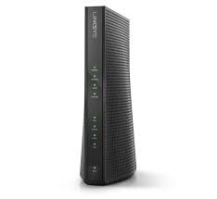
Modem
Modulator and Demodulator (Modem) connects the computer to the internet over the existing telephone line.
A modem is not integrated with the computer motherboard.
A modem is a separate part on the PC slot found on the motherboard.

Slide 32
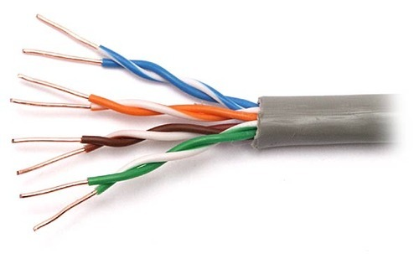
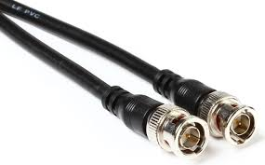
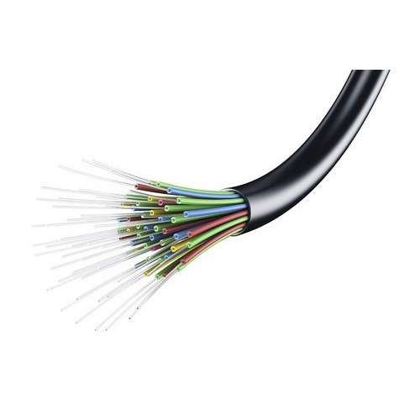
Cables and connectors
Cable is a transmission media that transmits the communication signals. There are three types of cables:
Twisted pair cable: It is a high-speed cable that transmits the data over 1Gbps or more.
Coaxial cable: Coaxial cable resembles like a TV installation cable. it provides the high data transmission speed.
Fibre optic cable: Fibre optic cable is a high-speed cable that transmits the data using light beams. It provides high data transmission speed as compared to other cables. Fibre
Twisted Pair
Fibre Optics cable
Coaxial Cable

Slide 33
Other Devices
Bridges – HW and SW
Gateways
intrusion detection system (IDS)- Security
Firewall- Security

Slide 34
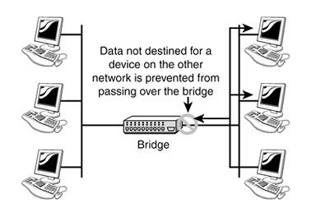
Bridges
A network bridge is a computer networking device that creates a single aggregate network from multiple communication networks or network segments. This function is called network bridging. Bridging is distinct from routing.
How a bridge is used to segregate networks.

Slide 35
Bridges
Bridges are used to divide larger networks into smaller sections.
Bridges can also be used to connect two physical LANs into a larger logical LAN.

Slide 36
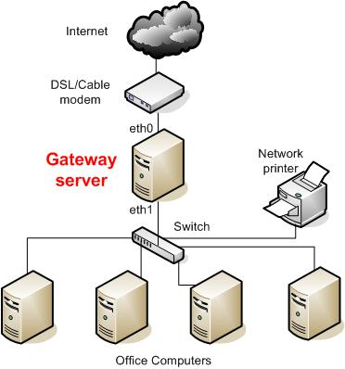
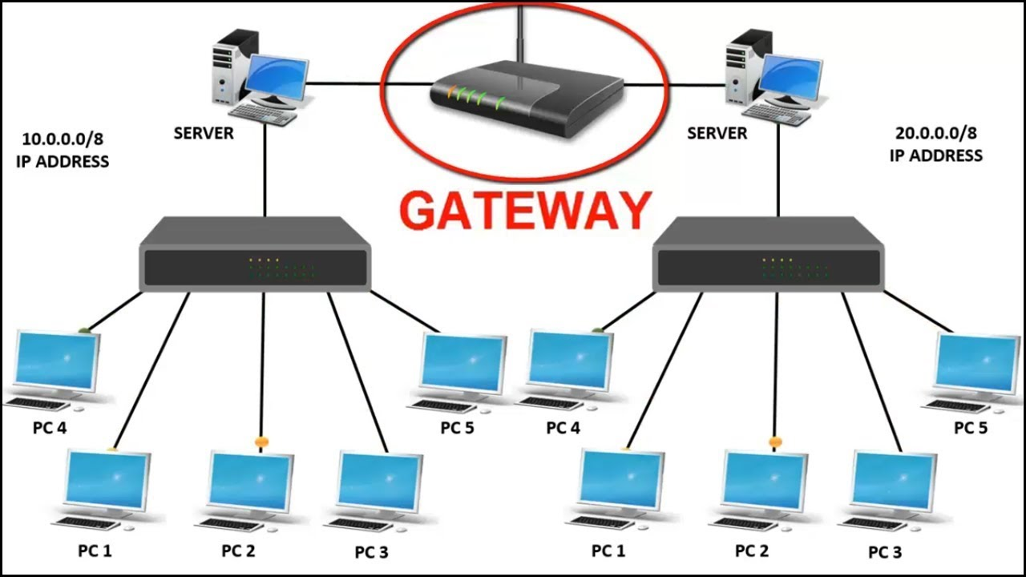
Gateway
A gateway is a node (router) in a computer network, a key stopping point for data on its way to or from other networks. Any device that translates one data format to another is called a gateway.

Slide 37
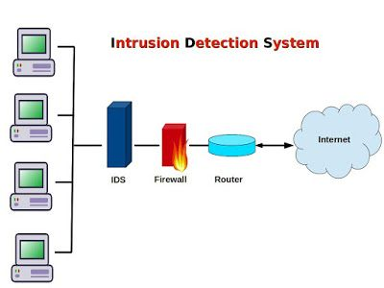
Intrusion Detection System (IDS)
An Intrusion Detection System (IDS) is a network security technology originally built for detecting vulnerability exploits against a target application or computer

Slide 38
Firewall
A firewall is a system designed to prevent unauthorized access to or from a private network. You can implement a firewall in either hardware or software form, or a combination of both. Firewalls prevent unauthorized internet users from accessing private networks connected to the internet, especially intranets.

Slide 39
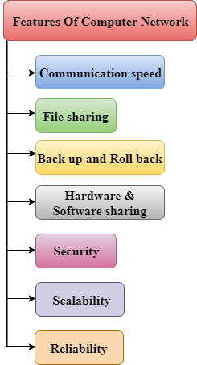

Slide 40
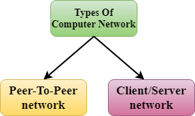
Computer Network Architecture
Computer Network Architecture is defined as the physical and logical design of the software, hardware, protocols, and media of the transmission of data. Simply we can say that how computers are organized and how tasks are allocated to the computer.
The two types of network architectures are used:

Slide 41
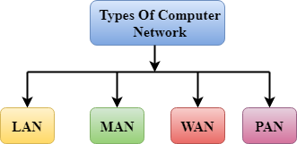
Types of computer networks
A computer network can be categorized by their size. A computer network is mainly of four types:
LAN(Local Area Network)
PAN (Personal Area Network)
MAN(Metropolitan Area Network)
WAN(Wide Area Network)

Slide 42
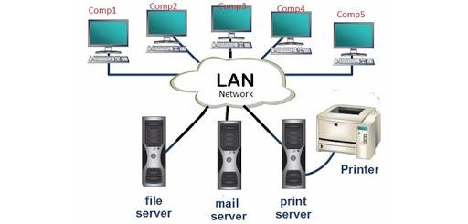
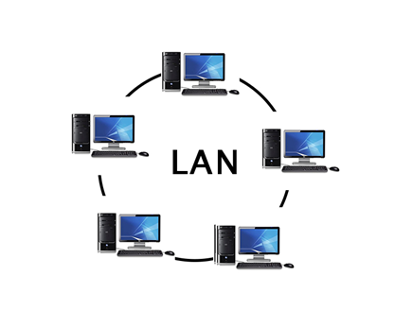
LAN – Local Area Network

Slide 43
LAN – Local Area Network
The geographical coverage is small, only in a relatively independent local area within the joint, such as a centralized building.
It uses the special laid transmission media for networking, delivering high data transfer rate (10Mbs - 10Gbs)
Communication delay time is short. High reliability.
LAN can support a variety of transmission media.

Slide 44
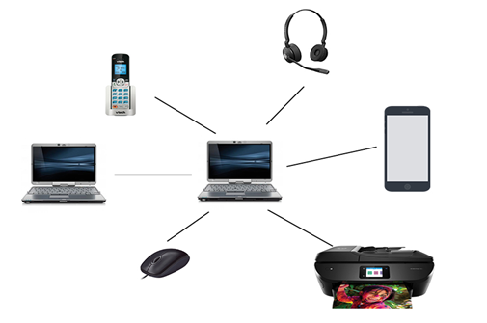
PAN – Personal Area Network
A personal area network, or PAN, is a computer network that enables communication between computer devices near a person. PANs can be wired, such as USB or FireWire, or they can be wireless, such as infrared, ZigBee, Bluetooth and ultra wideband, or UWB. The range of a PAN typically is a few meters.

Slide 45
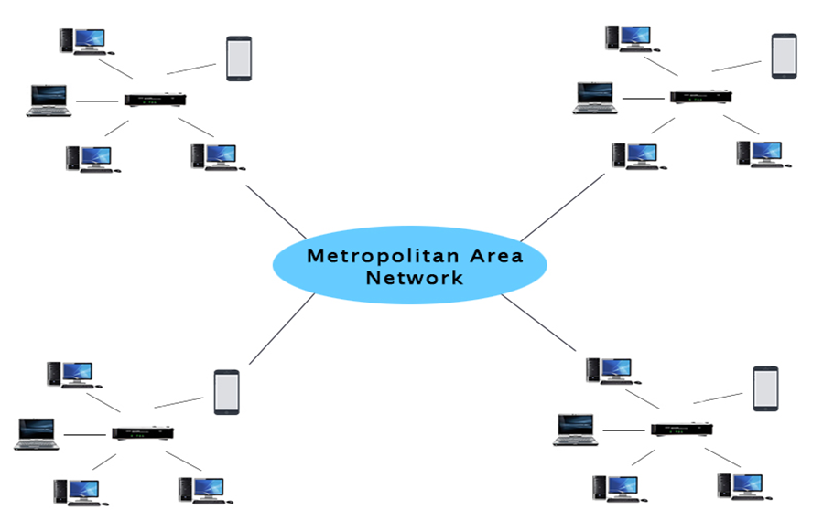
MAN- Metropolitan Area Network

Slide 46
MAN
A MAN is a relatively new class of network, it serves a role similar to an ISP, but for corporate users with large LANs.
A MAN (like a WAN) is not generally owned by a single organisation.
The MAN, its communications links and equipment are generally owned by either a consortium of users
or by a single network provider who sells the service to the users.

Slide 47
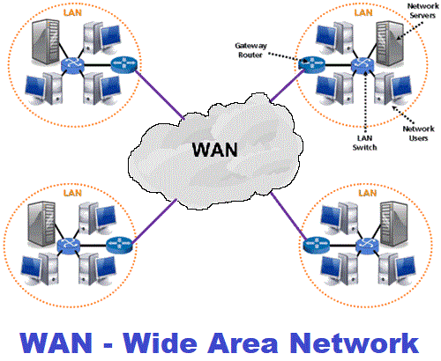
WAN- Wide Area Network

Slide 48
WAN
WANs have a large capacity, connecting a large number of computers over a large area, and are inherently scalable.
They facilitate the sharing of regional resources.
Communication links are provided by public carriers like telephone networks, network providers, cable systems, satellites etc.
Typically, they have low data transfer rate and high propagation delay, i.e. they have low communication speed.
They generally have a higher bit error rate

Slide 49
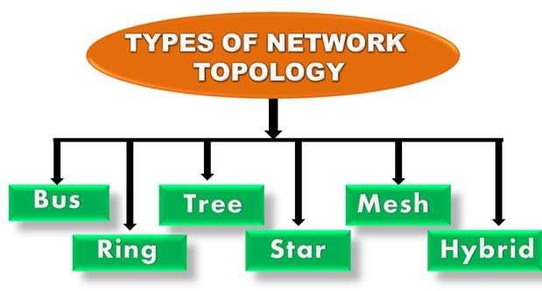
What is Topology?
Topology defines the structure of the network of how all the components are interconnected to each other.
There are two types of topology: physical and logical topology.
Physical topology is the geometric representation of all the nodes in a network.

Slide 50
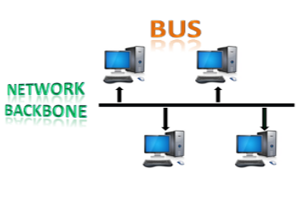
Bus Topology

Slide 51
Bus Topology
The bus topology is all the stations (nodes) are connected through a single cable known as a backbone cable.
Each node is connected to the backbone cable by drop cable (LAN Chord) or directly connected to the backbone cable.
When a node wants to send a message over the network, it puts a message over the network. All the stations will receive the message whether it has been addressed or not.
The bus topology is mainly used in 802.3 (Ethernet) and 802.4 standard networks.
The backbone cable is considered as a "single lane" through which the message is broadcast to all the stations.
The most common access method of the bus topologies is CSMA (Carrier Sense Multiple Access).

Slide 52
Bus Topology
Advantages of Bus topology:
Low-cost cable: nodes are directly connected to the cable without passing through a hub.
Moderate data speeds: Coaxial or twisted pair cables are mainly used in bus-based networks that support up to 10 Mbps.
Familiar technology: as the installation, troubleshooting techniques are easy and hardware components are easily available.
Limited failure: A failure in one node will not have any effect on other nodes.

Slide 53
Bus Topology
Disadvantages of Bus topology:
Extensive cabling: but still it requires a lot of cabling.
Difficult troubleshooting: It requires specialized test equipment to determine the cable faults. If any fault occurs in the cable, then it would disrupt the communication for all the nodes.
Signal interference: If two nodes send the messages at a time, the signals of both the nodes collide.
Reconfiguration difficult: Adding new devices to the network would slow down the network.
Attenuation: Attenuation is a loss of signal leads to communication issues. Repeaters are used to regenerate the signal.

Slide 54
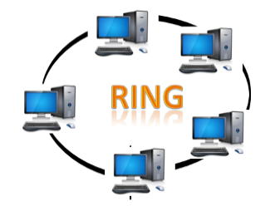
Ring Topology

Slide 55
Ring Topology
Ring topology is like a bus topology, but with connected ends.
The node that receives the message from the previous computer will retransmit to the next node.
The data flows in one direction, i.e., it is unidirectional.
The data flows in a single loop continuously known as an endless loop.
It has no terminated ends, i.e., each node is connected to other node and having no termination point.
The data in a ring topology flow in a clockwise direction.
The most common access method of the ring topology is token passing.
Token passing: It is a network access method in which token is passed from one node to another node.
Token: It is a frame that circulates around the network.

Slide 56
Ring Topology- Working of Token passing
A token moves around the network, and it is passed from computer to computer until it reaches the destination.
The sender modifies the token by putting the address along with the data.
The data is passed from one device to another device until the destination address matches. Once the token received by the destination device, then it sends the acknowledgment to the sender.
In a ring topology, a token is used as a carrier.

Slide 57
Ring Topology
Advantages of Ring topology:
Network Management: Faulty devices can be removed from the network without bringing the network down.
Product availability: Many hardware and software tools for network operation and monitoring are available.
Cost: Twisted pair cabling is inexpensive and easily available. Therefore, the installation cost is very low.
Reliable: It is a more reliable network because the communication system is not dependent on the single host computer.
Disadvantages of Ring topology:
Difficult troubleshooting: It requires specialized test equipment to determine the cable faults. If any fault occurs in the cable, then it would disrupt the communication for all the nodes.
Failure: The breakdown in one station leads to the failure of the overall network.
Reconfiguration difficult: Adding new devices to the network would slow down the network.
Delay: Communication delay is directly proportional to the number of nodes. Adding new devices increases the communication delay.

Slide 58
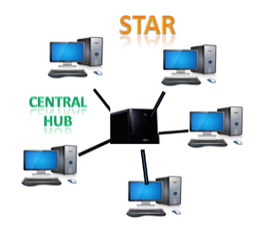
Star Topology

Slide 59
Star Topology
Star topology is an arrangement of the network in which every node is connected to the central hub, switch or a central computer.
The central computer is known as a server, and the peripheral devices attached to the server are known as clients.
Coaxial cable or RJ-45 cables are used to connect the computers.
Hubs or Switches are mainly used as connection devices in a physical star topology.
Star topology is the most popular topology in network implementation.

Slide 60
Star Topology
Advantages of Star topology
Efficient troubleshooting: Troubleshooting is quite efficient in a star topology as compared to bus topology. In a bus topology, the manager has to inspect the kilo meters of cable. In a star topology, all the stations are connected to the centralized network.
Network control: Complex network control features can be easily implemented in the star topology. Any changes made in the star topology are automatically accommodated.
Limited failure: As each station is connected to the central hub with its own cable, therefore failure in one cable will not affect the entire network.
Familiar technology: Star topology is a familiar technology as its tools are cost-effective.
Easily expandable: It is easily expandable as new stations can be added to the open ports on the hub.
Cost effective: Star topology networks are cost-effective as it uses inexpensive coaxial cable.
High data speeds: It supports a bandwidth of approx 100Mbps. Ethernet 100BaseT is one of the most popular Star topology networks.
Disadvantages of Star topology
A Central point of failure: If the central hub or switch goes down, then all the connected nodes will not be able to communicate with each other.
Cable: Sometimes cable routing becomes difficult when a significant amount of routing is required.

Slide 61
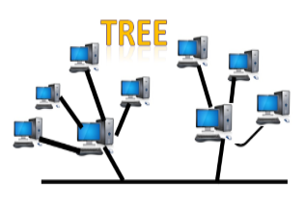
Tree topology

Slide 62
Tree topology
Tree topology combines the characteristics of bus topology and star topology.
A tree topology is a type of structure in which all the computers are connected with each other in hierarchical fashion.
The top-most node in tree topology is known as a root node, and all other nodes are the descendants of the root node.
There is only one path exists between two nodes for the data transmission. Thus, it forms a parent-child hierarchy.

Slide 63
Tree topology
Advantages of Tree topology
Support for broadband transmission: Tree topology is mainly used to provide broadband transmission, i.e., signals are sent over long distances without being attenuated.
Easily expandable: We can add the new device to the existing network.
Easily manageable: In tree topology, the whole network is divided into segments known as star networks which can be easily managed and maintained.
Error detection: Error detection and error correction are very easy in a tree topology.
Limited failure: The breakdown in one station does not affect the entire network.
Point-to-point wiring: It has point-to-point wiring for individual segments.
Disadvantages of Tree topology
Difficult troubleshooting: If any fault occurs in the node, then it becomes difficult to troubleshoot the problem.
High cost: Devices required for broadband transmission are very costly.
Failure: A tree topology mainly relies on main bus cable and failure in main bus cable will damage the overall network.
Reconfiguration difficult: If new devices are added, then it becomes difficult to reconfigure.

Slide 64
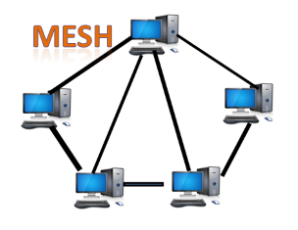
Mesh topology

Slide 65
Mesh topology
Mesh technology is an arrangement of the network in which computers are interconnected with each other through various redundant connections.
There are multiple paths from one computer to another computer.
It does not contain the switch, hub or any central computer which acts as a central point of communication.
The Internet is an example of the mesh topology.
Mesh topology is mainly used for WAN implementations where communication failures are a critical concern.
Mesh topology is mainly used for wireless networks.
Mesh topology can be formed by using the formula: Number of cables = (n*(n-1))/2; Where n is the number of nodes that represents the network.

Slide 66
Mesh topology
Advantages of Mesh topology:
Reliable: The mesh topology networks are very reliable as if any link breakdown will not affect the communication between connected computers.
Fast Communication: Communication is very fast between the nodes.
Easier Reconfiguration: Adding new devices would not disrupt the communication between other devices.
Disadvantages of Mesh topology
Cost: A mesh topology contains a large number of connected devices such as a router and more transmission media than other topologies.
Management: Mesh topology networks are very large and very difficult to maintain and manage. If the network is not monitored carefully, then the communication link failure goes undetected.
Efficiency: In this topology, redundant connections are high that reduces the efficiency of the network.

Slide 67
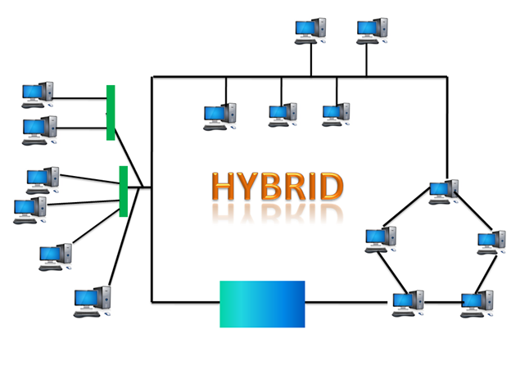
Hybrid Topology

Slide 68
Hybrid Topology
The combination of various different topologies is known as Hybrid topology.
A Hybrid topology is a connection between different links and nodes to transfer the data.
When two or more different topologies are combined together is termed as Hybrid topology and if similar topologies are connected with each other will not result in Hybrid topology. For example, if there exist a ring topology in one branch of ICICI bank and bus topology in another branch of ICICI bank, connecting these two topologies will result in Hybrid topology.

Slide 69
Hybrid Topology
Advantages of Hybrid Topology
Reliable: If a fault occurs in any part of the network will not affect the functioning of the rest of the network.
Scalable: Size of the network can be easily expanded by adding new devices without affecting the functionality of the existing network.
Flexible: This topology is very flexible as it can be designed according to the requirements of the organization.
Effective: Hybrid topology is very effective as it can be designed in such a way that the strength of the network is maximized and weakness of the network is minimized.
Disadvantages of Hybrid topology
Complex design: The major drawback of the Hybrid topology is the design of the Hybrid network. It is very difficult to design the architecture of the Hybrid network.
Costly Hub: The Hubs used in the Hybrid topology are very expensive as these hubs are different from usual Hubs used in other topologies.
Costly infrastructure: The infrastructure cost is very high as a hybrid network requires a lot of cabling, network devices, etc.

Slide 70
Protocol Hierarchy
A protocol is an agreement between the communicating parties on how the communication is to proceed.
The first computer networks were designed with the hardware as the main concern and the software as an after thought. To reduce their design complexity, most networks are organized as a series or hierarchy of layers or levels.
The number of layers, the name of each layer, the contents of each layer, and the function of each layer differ from network to network.
Layer n on one machine communicates with layer n on another machine on the network using an some rules known as the layer n protocol.
Below layer 1 is the physical medium through which actual communication occur over communication channels.
Between each pair of adjacent layers there is an interface.
The interface defines which primitive operations and services the lower layer offers to the upper layer.
The set of layers and associated protocols is called network architecture.

Slide 71
Transmission modes
The way in which data is transmitted from one device to another device is known as transmission mode.
The transmission mode is also known as the communication mode.
Each communication channel has a direction associated with it, and transmission media provide the direction. Therefore, the transmission mode is also known as a directional mode.
The transmission mode is defined in the physical layer.

Slide 72
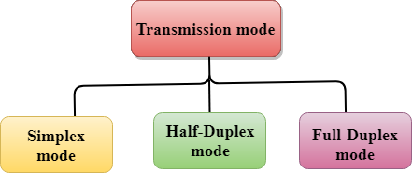
Transmission modes

Slide 73
Simplex mode
In Simplex mode, the communication is unidirectional, i.e., the data flow in one direction.
A device can only send the data but cannot receive it or it can receive the data but cannot send the data.
This transmission mode is not very popular as mainly communications require the two-way exchange of data. The simplex mode is used in the business field as in sales that do not require any corresponding reply.
The radio station is a simplex channel as it transmits the signal to the listeners but never allows them to transmit back.
Keyboard and Monitor are the examples of the simplex mode as a keyboard can only accept the data from the user and monitor can only be used to display the data on the screen.
The main advantage of the simplex mode is that the full capacity of the communication channel can be utilized during transmission.

Slide 74

Simplex mode
Advantage of Simplex mode:
In simplex mode, the station can utilize the entire bandwidth of the communication channel, so that more data can be transmitted at a time.
Disadvantage of Simplex mode:
Communication is unidirectional, so it has no inter-communication between devices.

Slide 75
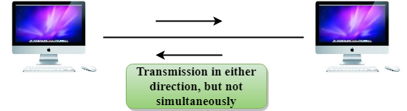
Half-Duplex mode

Slide 76
Half-Duplex Mode
In a Half-duplex channel, direction can be reversed, i.e., the station can transmit and receive the data as well.
Messages flow in both the directions, but not at the same time.
The entire bandwidth of the communication channel is utilized in one direction at a time.
In half-duplex mode, it is possible to perform the error detection, and if any error occurs, then the receiver requests the sender to retransmit the data.
A Walkie-talkie is an example of the Half-duplex mode. In Walkie-talkie, one party speaks, and another party listens. After a pause, the other speaks and first party listens. Speaking simultaneously will create the distorted sound which cannot be understood.

Slide 77
Half-Duplex Mode
Advantage of Half-duplex mode:
In half-duplex mode, both the devices can send and receive the data and also can utilize the entire bandwidth of the communication channel during the transmission of data.
Disadvantage of Half-Duplex mode:
In half-duplex mode, when one device is sending the data, then another has to wait, this causes the delay in sending the data at the right time.

Slide 78

Full-Duplex Mode

Slide 79
Full-Duplex Mode
In Full duplex mode, the communication is bi-directional, i.e., the data flow in both the directions.
Both the stations can send and receive the message simultaneously.
Full-duplex mode has two simplex channels. One channel has traffic moving in one direction, and another channel has traffic flowing in the opposite direction.
The Full-duplex mode is the fastest mode of communication between devices.
The most common example of the full-duplex mode is a telephone network. When two people are communicating with each other by a telephone line, both can talk and listen at the same time.

Slide 80
Full-Duplex Mode
Advantage of Full-duplex mode:
Both the stations can send and receive the data at the same time.
Disadvantage of Full-duplex mode:
If there is no dedicated path exists between the devices, then the capacity of the communication channel is divided into two parts.

Slide 81
Differences b/w Simplex, Half-duplex and Full-duplex mode
Basis for comparison | Simplex mode | Half-duplex mode | Full-duplex mode
Direction of communication | In simplex mode, the communication is unidirectional. | In half-duplex mode, the communication is bidirectional, but one at a time. | In full-duplex mode, the communication is bidirectional.
Send/Receive | A device can only send the data but cannot receive it or it can only receive the data but cannot send it. | Both the devices can send and receive the data, but one at a time. | Both the devices can send and receive the data simultaneously.
Performance | The performance of half-duplex mode is better than the simplex mode. | The performance of full-duplex mode is better than the half-duplex mode. | The Full-duplex mode has better performance among simplex and half-duplex mode as it doubles the utilization of the capacity of the communication channel.
Example | Examples of Simplex mode are radio, keyboard, and monitor. | Example of half-duplex is Walkie-Talkies. | Example of the Full-duplex mode is a telephone network.

Slide 82
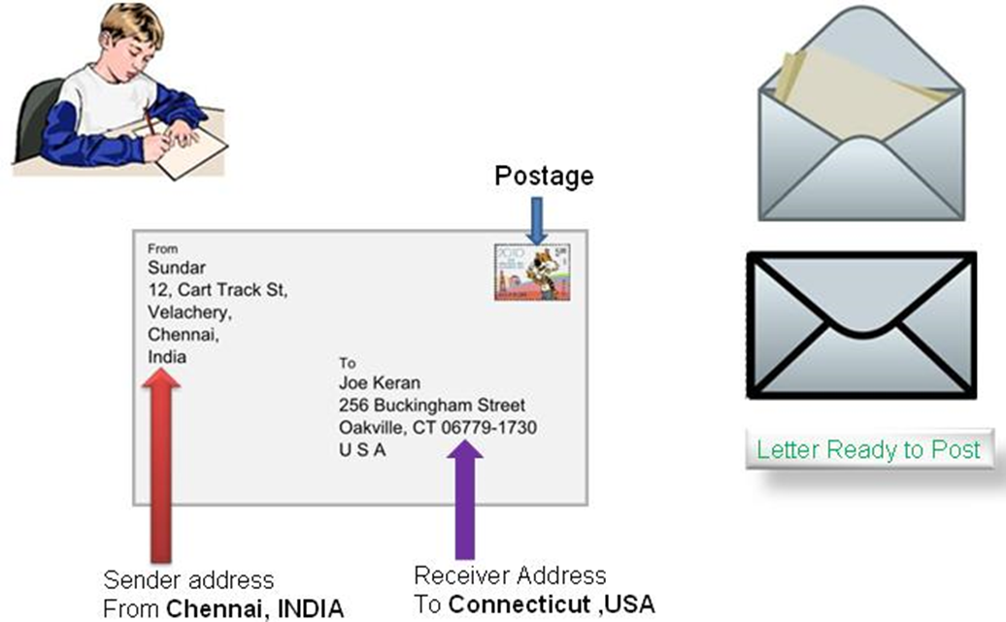
Postal Communication

Slide 83

Postal Communication

Slide 84

Protocol Hierarchy

Slide 85
Why do we require Layered architecture?
Divide-and-conquer approach: Divide-and-conquer approach makes a design process in such a way that the unmanageable tasks are divided into small and manageable tasks. In short, we can say that this approach reduces the complexity of the design.
Modularity: Layered architecture is more modular. Modularity provides the independence of layers, which is easier to understand and implement.
Easy to modify: It ensures the independence of layers so that implementation in one layer can be changed without affecting other layers.
Easy to test: Each layer of the layered architecture can be analyzed and tested individually.

Slide 86
OSI Model
OSI stands for Open System Interconnection is a reference model that describes how information from a software application in one computer moves through a physical medium to the software application in another computer.
OSI consists of seven layers, and each layer performs a particular network function.
OSI model was developed by the International Organization for Standardization (ISO) in 1984, and it is now considered as an architectural model for the inter-computer communications.
OSI model divides the whole task into seven smaller and manageable tasks. Each layer is assigned a particular task.
Each layer is self-contained, so that task assigned to each layer can be performed independently.

Slide 87

Characteristics of OSI Model:

Slide 88

Functions of the OSI Layers

Slide 89

Physical layer

Slide 90
Functions of a Physical layer:
Line Configuration: It defines the way how two or more devices can be connected physically.
Data Transmission: It defines the transmission mode whether it is simplex, half-duplex or full-duplex mode between the two devices on the network.
Topology: It defines the way how network devices are arranged.
Signals: It determines the type of the signal used for transmitting the information.

Slide 91

Data-Link Layer

Slide 92
Data-Link Layer
This layer is responsible for the error-free transfer of data frames.
It defines the format of the data on the network.
It provides a reliable and efficient communication between two or more devices.
It is mainly responsible for the unique identification of each device that resides on a local network.

Slide 93
Data-Link Layer
It contains two sub-layers:
Logical Link Control Layer
It is responsible for transferring the packets to the Network layer of the receiver that is receiving.
It identifies the address of the network layer protocol from the header. It also provides flow control.
Media Access Control Layer
A Media access control layer is a link between the Logical Link Control layer and the network's physical layer. It is used for transferring the packets over the network.

Slide 94
Functions of the Data-link layer
Framing: It translates the physical's raw bit stream into packets known as Frames.
Physical Addressing: It adds a header to the frame that contains a destination address. The frame is transmitted to the destination address mentioned in the header.
Flow Control: It is the technique through which the constant data rate is maintained on both the sides so that no data get corrupted. It ensures that the transmitting station such as a server with higher processing speed does not exceed the receiving station, with lower processing speed.

Slide 95
Functions of the Data-link layer
Error Control: Error control is achieved by adding a calculated value CRC (Cyclic Redundancy Check) trailer which is added to the message frame before it is sent to the physical layer. If any error seems to occur, then the receiver sends the acknowledgment for the retransmission of the corrupted frames.
Access Control: When two or more devices are connected to the same communication channel, then the data link layer protocols are used to determine which device has control over the link at a given time.

Slide 96

Network Layer

Slide 97
Network Layer
It is a layer 3 that manages device addressing, tracks the location of devices on the network.
It determines the best path to move data from source to the destination based on the network conditions, the priority of service, and other factors.
The Data link layer is responsible for routing and forwarding the packets.
Routers are the layer 3 devices, they are specified in this layer and used to provide the routing services within an internetwork.
The protocols used to route the network traffic are known as Network layer protocols. Examples of protocols are IP and Ipv6.

Slide 98
Network Layer
Functions of Network Layer:
Internetworking: An internetworking is the main responsibility of the network layer. It provides a logical connection between different devices.
Addressing: A Network layer adds the source and destination address to the header of the frame. Addressing is used to identify the device on the internet.
Routing: Routing is the major component of the network layer, and it determines the best optimal path out of the multiple paths from source to the destination.
Packetizing: A Network Layer receives the packets from the upper layer and converts them into packets. This process is known as Packetizing. It is achieved by internet protocol (IP).

Slide 99

Transport Layer

Slide 100
Transport Layer
The Transport layer is a Layer 4 ensures that messages are transmitted in the order in which they are sent and there is no duplication of data.
The main responsibility of the transport layer is to transfer the data completely.
It receives the data from the upper layer and converts them into smaller units known as segments.
This layer can be termed as an end-to-end layer as it provides a point-to-point connection between source and destination to deliver the data reliably.

Slide 101
Transport Layer
The two protocols used in this layer are:
Transmission Control Protocol
It is a standard protocol that allows the systems to communicate over the internet.
It establishes and maintains a connection between hosts.
When data is sent over the TCP connection, then the TCP protocol divides the data into smaller units known as segments. Each segment travels over the internet using multiple routes, and they arrive in different orders at the destination. The transmission control protocol reorders the packets in the correct order at the receiving end.

Slide 102
Transport Layer
The two protocols used in this layer are:
User Datagram Protocol
User Datagram Protocol is a transport layer protocol.
It is an unreliable transport protocol as in this case receiver does not send any acknowledgment when the packet is received, the sender does not wait for any acknowledgment. Therefore, this makes a protocol unreliable.

Slide 103
Functions of Transport Layer:
Service-point addressing: Computers run several programs simultaneously due to this reason, the transmission of data from source to the destination not only from one computer to another computer but also from one process to another process. The transport layer adds the header that contains the address known as a service-point address or port address. The responsibility of the network layer is to transmit the data from one computer to another computer and the responsibility of the transport layer is to transmit the message to the correct process.
Segmentation and reassembly: When the transport layer receives the message from the upper layer, it divides the message into multiple segments, and each segment is assigned with a sequence number that uniquely identifies each segment. When the message has arrived at the destination, then the transport layer reassembles the message based on their sequence numbers.

Slide 104
Functions of Transport Layer:
Connection control: Transport layer provides two services Connection-oriented service and connectionless service. A connectionless service treats each segment as an individual packet, and they all travel in different routes to reach the destination. A connection-oriented service makes a connection with the transport layer at the destination machine before delivering the packets. In connection-oriented service, all the packets travel in the single route.
Flow control: The transport layer also responsible for flow control but it is performed end-to-end rather than across a single link.
Error control: The transport layer is also responsible for Error control. Error control is performed end-to-end rather than across the single link. The sender transport layer ensures that message reach at the destination without any error.

Slide 105

Session Layer

Slide 106
Session Layer
It is a layer 3 in the OSI model.
The Session layer is used to establish, maintain and synchronizes the interaction between communicating devices.

Slide 107
Session Layer
Functions of Session layer:
Dialog control: Session layer acts as a dialog controller that creates a dialog between two processes or we can say that it allows the communication between two processes which can be either half-duplex or full-duplex.
Synchronization: Session layer adds some checkpoints when transmitting the data in a sequence. If some error occurs in the middle of the transmission of data, then the transmission will take place again from the checkpoint. This process is known as Synchronization and recovery.

Slide 108

Presentation Layer

Slide 109
Presentation Layer
A Presentation layer is mainly concerned with the syntax and semantics of the information exchanged between the two systems.
It acts as a data translator for a network.
This layer is a part of the operating system that converts the data from one presentation format to another format.
The Presentation layer is also known as the syntax layer.

Slide 110
Presentation Layer
Functions of Presentation layer:
Translation: The processes in two systems exchange the information in the form of character strings, numbers and so on. Different computers use different encoding methods, the presentation layer handles the interoperability between the different encoding methods. It converts the data from sender-dependent format into a common format and changes the common format into receiver-dependent format at the receiving end.

Slide 111
Presentation Layer
Functions of Presentation layer:
Encryption: Encryption is needed to maintain privacy. Encryption is a process of converting the sender-transmitted information into another form and sends the resulting message over the network.
Compression: Data compression is a process of compressing the data, i.e., it reduces the number of bits to be transmitted. Data compression is very important in multimedia such as text, audio, video.

Slide 112

Application Layer

Slide 113
Application Layer
An application layer serves as a window for users and application processes to access network service.
It handles issues such as network transparency, resource allocation, etc.
An application layer is not an application, but it performs the application layer functions.
This layer provides the network services to the end-users.

Slide 114
Application Layer
Functions of Application layer:
File transfer, access, and management (FTAM): An application layer allows a user to access the files in a remote computer, to retrieve the files from a computer and to manage the files in a remote computer.
Mail services: An application layer provides the facility for email forwarding and storage.
Directory services: An application provides the distributed database sources and is used to provide that global information about various objects.

Slide 115
TCP/IP model
The TCP/IP model was developed prior to the OSI model.
The TCP/IP model is not exactly similar to the OSI model.
The TCP/IP model consists of five layers: the application layer, transport layer, network layer, data link layer and physical layer.
The first four layers provide physical standards, network interface, internetworking, and transport functions that correspond to the first four layers of the OSI model and these four layers are represented in TCP/IP model by a single layer called the application layer.
TCP/IP is a hierarchical protocol made up of interactive modules, and each of them provides specific functionality.
Here, hierarchical means that each upper-layer protocol is supported by two or more lower-level protocols.

Slide 116

TCP/IP Model

Slide 117
Network Access Layer
A network layer is the lowest layer of the TCP/IP model.
A network layer is the combination of the Physical layer and Data Link layer defined in the OSI reference model.
It defines how the data should be sent physically through the network.
This layer is mainly responsible for the transmission of the data between two devices on the same network.
The functions carried out by this layer are encapsulating the IP datagram into frames transmitted by the network and mapping of IP addresses into physical addresses.
The protocols used by this layer are ethernet, token ring, FDDI, X.25, frame relay.

Slide 118
Internet Layer
An internet layer is the second layer of the TCP/IP model.
An internet layer is also known as the network layer.
The main responsibility of the internet layer is to send the packets from any network, and they arrive at the destination irrespective of the route they take.

Slide 119
Transport Layer
The transport layer is responsible for the reliability, flow control, and correction of data which is being sent over the network.
The two protocols used in the transport layer are User Datagram protocol and Transmission control protocol.

Slide 120
Application Layer
An application layer is the topmost layer in the TCP/IP model.
It is responsible for handling high-level protocols, issues of representation.
This layer allows the user to interact with the application.
When one application layer protocol wants to communicate with another application layer, it forwards its data to the transport layer.
There is an ambiguity occurs in the application layer. Every application cannot be placed inside the application layer except those who interact with the communication system. For example: text editor cannot be considered in application layer while web browser using HTTP protocol to interact with the network where HTTP protocol is an application layer protocol.

Slide 121
Assignment 1 ( Please submit in digital form)
Roll No | Question
1 | What is Computer Network? Can you make use Computer network in your Home. If yes How? If not why not?
2 | How CN can be used in KG School to carry out the day to day activities? Discuss.
3 | How the farmer can make use of CN? Discuss in detail.
4 | How your institute is making use of CN in its day to day activities? Identify and suggest some more ways of using CN.
5 | How the Banks are making use of CN? Discuss it with the example of the Bank with which you’re having an a/c. Suggest what other improvements it can do.

Slide 122
Assignment 1 ( Please submit in digital form)
Roll No | Question
6 | How Indian Railways is making use of CN? Discuss and suggest the other avenues of CN which it can make use of.
7 | The Chief minister of Maharashtra want to communicate with needy citizens. What are the different ways to achieve this using CN.
8 | The CEO of Tata Group wants to address to the share holders, then which can be the best way communicate? Why? What can be the other ways.
9 | A company wants to make survey about its product using CN, can you suggest the different ways it use?
10 | What are the different ways of communication to communicate with your brother who is staying in USA? Justify the best one.

Slide 123
Assignment 1 ( Please submit in digital form)
Roll No | Question
11 | What is NIC? Why do we require this? Does your Laptop has NIC? If yes what type of NIC it is having? Discuss.
12 | Assume you are having a PC with inbuilt NIC but it is not working. How do you over come this issue to connect your PC with internet. Discuss.
13 | What is MODEM? How it works? How it can be used in CN? What are the advantages and disadvantages of MODEM?
14 | What is HUB? Can we use this device to connect PC to internet? What are advantages and disadvantages of HUB.
15 | What is switch? How it is better than HUB? Explain its working? How it increases the speed?

Slide 124
Assignment 1 ( Please submit in digital form)
Roll No | Question
16 | What is switch? What can be the minimum and Maximum no of ports available? Name 5 companies which manufacture the Switches? Which companies switches are used in your Institute?
17 | What is Router? Why do we need this? Mention its functions? Does this have the memory in it?
18 | What is router? Name the manufacturers of routers? Mention minimum and maximum ports? Mention the advantages and disadvantages.
19 | Assume you are living with parents and a sibling. Every one is having smartphone and there is smart TV. How do you reduce the internet cost of your family? Justify your answer.
20 | The Institute want Establish computer lab with internet facility. What are the network components required? Justify your answer.

Slide 125
Assignment 1 ( Please submit in digital form)
Roll No | Question
21 | What are different types of cables used in CN? Mention the proper application where these can be used?
22 | What is Twisted pair cable? How many wires are there in it? Why they are different colours? Write their colour significance?
23 | What are different categories of Twisted pair cables? Mention their capabilities and limitations?
24 | Which are the companies involved in manufacturing twisted pair cables? Why it is better than BNC.
25 | What is BNC Cable? Mention different types of BNC cable and connector? Mention its limitations and advantages.

Slide 126
Assignment 1 ( Please submit in digital form)
Roll No | Question
26 | What is Fibre Optic Cable? Where do you find these cables? Can we use them in LAN?
27 | What is Fibre Optic Cable? Explain its working with schematic diagram?
28 | How Fibre Optic Cable is different from other cables? Which company has laid Fibre Optic Cable in India?
29 | Discuss the features of Computer Networks.
30 | What are the different type of network architectures? Mention their usage.

Slide 127
Assignment 1 ( Please submit in digital form)
Roll No | Question
31 | What is PAN? Mention the characteristics, advantages and disadvantages of PAN? Provide at least 2 live examples.
32 | What is LAN? Mention the characteristics, advantages and disadvantages of LAN? Provide at least 2 live examples.
33 | What is MAN? Mention the characteristics, advantages and disadvantages of MAN? Provide at least 2 live examples.
34 | What is WAN? Mention the characteristics, advantages and disadvantages of WAN? Provide at least 2 live examples.
35 | What are Internet and Intranet? If your institute wants establish Intranet, What are all required? Justify your answer.

Slide 128
Assignment 1 ( Please submit in digital form)
Roll No | Question
36 | What are topologies? Why these many topologies are required in CN? Justify your answer.
37 | Which topologies you suggest for PAN, LAN, MAN and WAN?
38 | What are CSMA-CD and CSMA-CA? Explain.
39 | What is token passing? In which topology it can be used effectively? Explain how it works.
40 | Explain Full mesh topology and Partial mesh topology.

Slide 129
Assignment 1 ( Please submit in digital form)
Roll No | Question
41 | What is hybrid topology? How hybrid topology can overcome deficiensies of other topologies? Justify you answer.
42 | What is Protocol? Discuss the need of protocol hierarchy.
43 | Why layered architecture is used in CN for communication? Justify
44 | What are the different modes of communication? Where these type of communication mode are used real life? Give examples.
45 | Why Full duplex is preferred in CN? Give valid reasons.

Slide 130
Assignment 1 ( Please submit in digital form)
Roll No | Question
46 | How Indian Railways is making use of CN? Discuss and suggest the other avenues of CN which it can make use of.
47 | The Chief minister of Maharashtra want to communicate with needy citizens. What are the different ways to achieve this using CN.
48 | The CEO of Tata Group wants to address to the share holders, then which can be the best way communicate? Why? What can be the other ways.
49 | A company wants to make survey about its product using CN, can you suggest the different ways it use?
50 | What are the different ways of communication to communicate with your brother who is staying in USA? Justify the best one.

Slide 131
Assignment 1 ( Please submit in digital form)
Roll No | Question
51 | What is NIC? Why do we require this? Does your Laptop has NIC? If yes what type of NIC it is having? Discuss.
52 | Assume you are having a PC with inbuilt NIC but it is not working. How do you over come this issue to connect your PC with internet. Discuss.
53 | What is MODEM? How it works? How it can be used in CN? What are the advantages and disadvantages of MODEM?
54 | What is HUB? Can we use this device to connect PC to internet? What are advantages and disadvantages of HUB.
55 | What is switch? How it is better than HUB? Explain its working? How it increases the speed?

Slide 132
Assignment 1 ( Please submit in digital form)
Roll No | Question
56 | What is switch? What can be the minimum and Maximum no of ports available? Name 5 companies which manufacture the Switches? Which companies switches are used in your Institute?
57 | What is Router? Why do we need this? Mention its functions? Does this have the memory in it?
58 | What is router? Name the manufacturers of routers? Mention minimum and maximum ports? Mention the advantages and disadvantages.
59 | Assume you are living with parents and a sibling. Every one is having smartphone and there is smart TV. How do you reduce the internet cost of your family? Justify your answer.
60 | The Institute want Establish computer lab with internet facility. What are the network components required? Justify your answer.

Slide 133
Assignment 1 ( Please submit in digital form)
Roll No | Question
61 | What are different types of cables used in CN? Mention the proper application where these can be used?
62 | What is Twisted pair cable? How many wires are there in it? Why they are different colours? Write their colour significance?
63 | What are different categories of Twisted pair cables? Mention their capabilities and limitations?
64 | Which are the companies involved in manufacturing twisted pair cables? Why it is better than BNC.
65 | What is BNC Cable? Mention different types of BNC cable and connector? Mention its limitations and advantages.

Slide 134
Assignment 1 ( Please submit in digital form)
Roll No | Question
66 | What is Fibre Optic Cable? Where do you find these cables? Can we use them in LAN?
67 | What is Fibre Optic Cable? Explain its working with schematic diagram?
68 | How Fibre Optic Cable is different from other cables? Which company has laid Fibre Optic Cable in India?
69 | Discuss the features of Computer Networks.
70 | What are the different type of network architectures? Mention their usage.

Slide 135
Assignment 1 ( Please submit in digital form)
Roll No | Question
71 | What is Computer Network? Can you make use Computer network in your Home. If yes How? If not why not?
72 | How CN can be used in KG School to carry out the day to day activities? Discuss.
73 | How the farmer can make use of CN? Discuss in detail.
74 | How your institute is making use of CN in its day to day activities? Identify and suggest some more ways of using CN.
75 | How the Banks are making use of CN? Discuss it with the example of the Bank with which you’re having an a/c. Suggest what other improvements it can do.

Slide 136
Assignment 1 ( Please submit in digital form)
Roll No | Question
76 | Why do we require Layered architecture? Which are four features considered make it layered?
77 | What are the different ways of communication to communicate with your brother who is staying in USA? Justify the best one.
78 | Explain Full mesh topology and Partial mesh topology.
79 | What is token passing? In which topology it can be used effectively? Explain how it works.

Slide 137
Topologies

Slide 138


